Slide 1

Hackathon 42KL
Lead: rbutarbu
Members: hetan ; iazmi

Slide 2

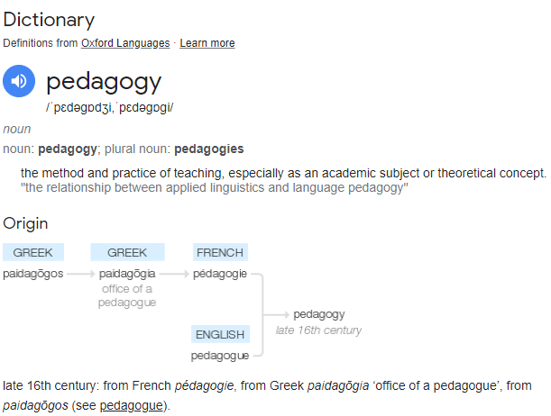




What is Pedagogy?!

Slide 3
Now you know what kind of idea we wanna give uhh?

Slide 4
Problems faced in current pedagogy
Peer to peer evaluation only during submission for cadets & pisciners might cause delays in project submission as they might get trouble to understand and also incorrect information from the internet.
Earning evaluation points is very difficult especially for those who are part time cadet who works during the weekday and only available during the night.
Great Cadet/Pisciners teachers often help other peers outside of evals however they’re good work goes untracked and unrewarded.

Slide 5
Idea: Create an application for pedadogogy
App title: 42_P2PL
App function:
Open for peer to peers learning. (one person to multiple)
Peer who open slot, other peers could subscribe for the slot which came with the learning title. e.g.: printf by rbutarbu, room: 0/5.
Each peer who had opened the slot will earn the points based on how much peers had subscribed.
Peer who opened slot can be made based on their own choice of venue.
Each Peer only can open slot once per week for fairness.

Slide 6
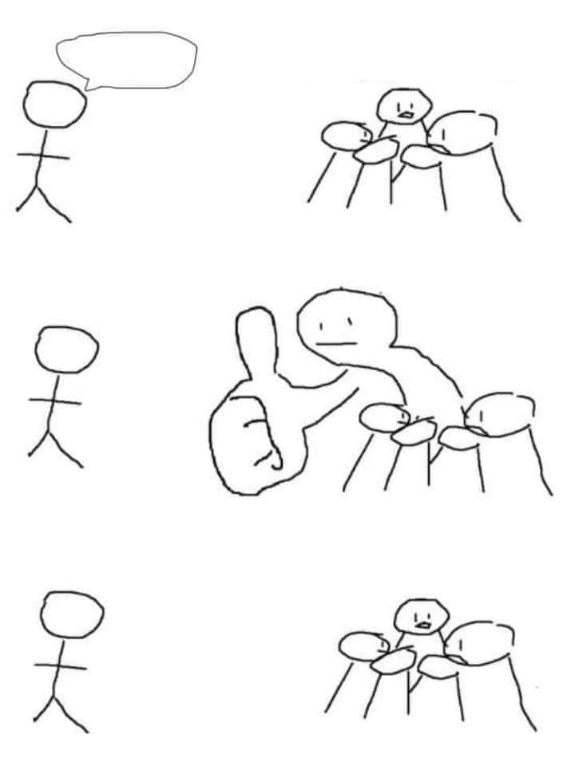

Key feature on app implementation
My idea is better
Flexibility and convenience on peer learning.
Peer who open a learning slot could keep track on their presentation quality from the peers who attend it. (rating and feedback system)
Peer who subscribe the learning slot also could benefit from the learning which 1 evaluation point contribute to the tutor.
Recognition will be given if the peer opened a slot in a certain mileage by rewarding Alterian dollar.

Slide 7
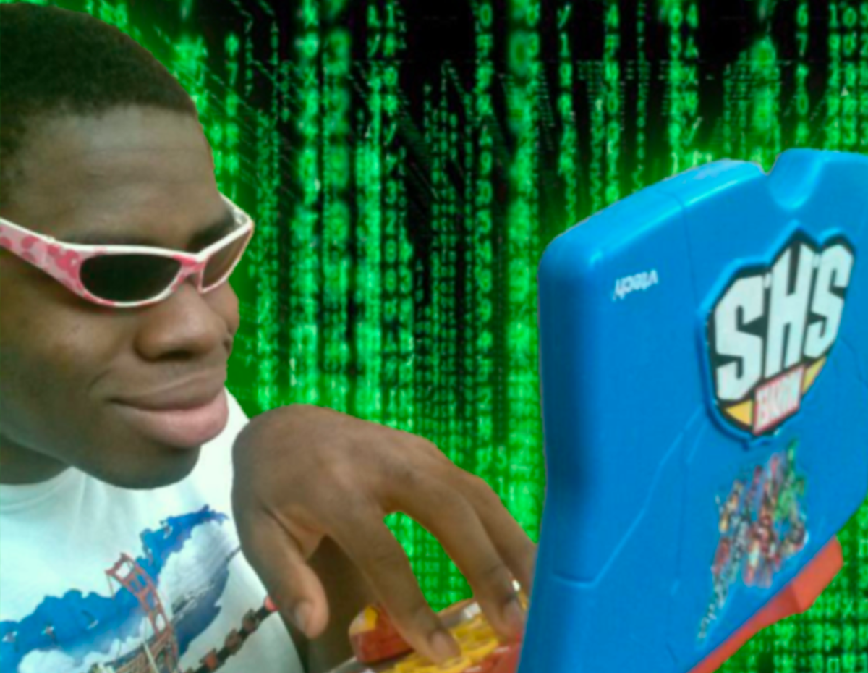
Application Demonstration

Slide 8
Q&A

Slide 9

Thank you :D

